Slide 1


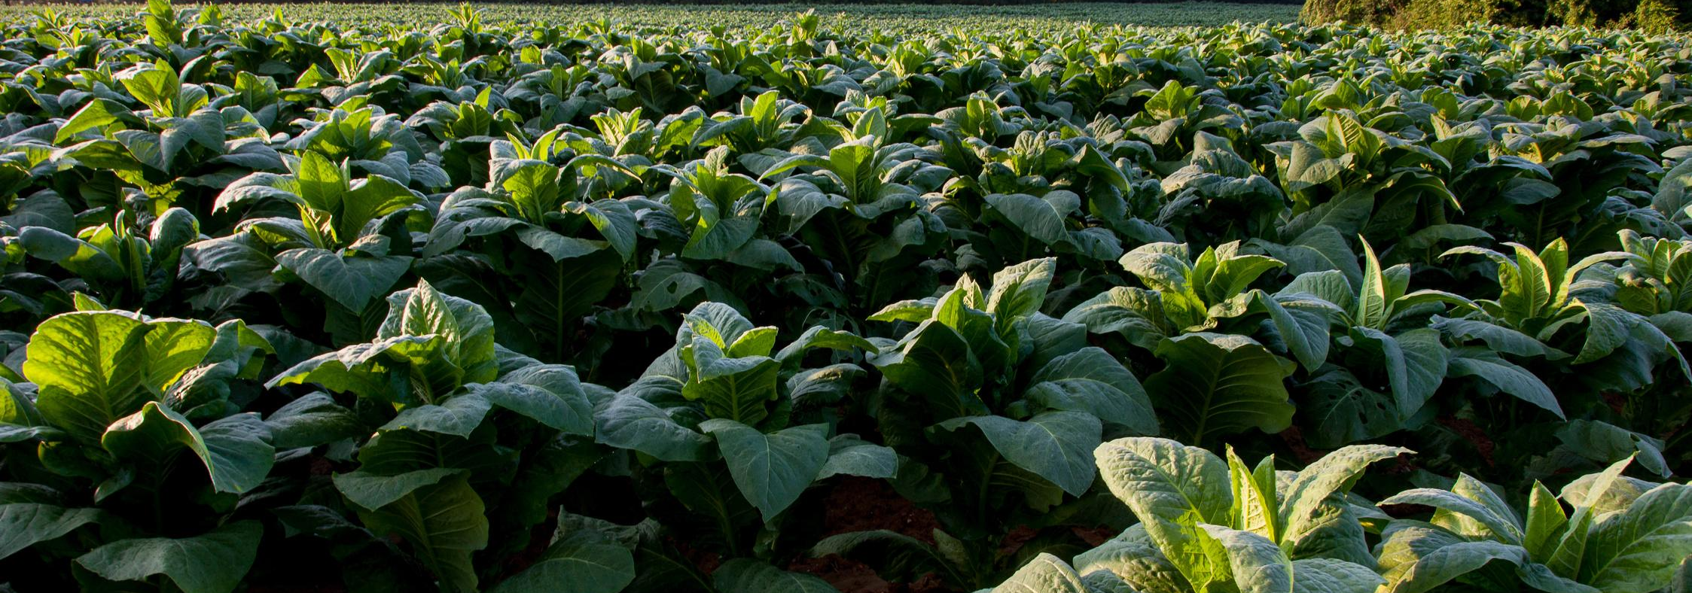
Roots & Returns
SCU Analytics Showdown
Group 9 : Tanish

Slide 2

5254
FARMERS DID NOT SELL BACK

Slide 3
Predictive Model
1
Develop a model to predict expected farmer yield and identify the most significant predictors
Input Effectiveness
The Challenge
2
Identify the components of the loan package that are most strongly associated with improved yield
Risk Identification
3
Can high risk farmers be segmented and flagged early in the season

Slide 4
The 4 Datasets
Farmer Details
Loan Details
Loan Details
Gender, Age, Agro-ecological Zone, Region, Number of Seasons
Input packages farmer received, Any programmes involved in
Planting Survey
Buy Back Details
How many seeds planted, Spacing used, When they were planted
Who sold, How much they sold, What price they received

Slide 5
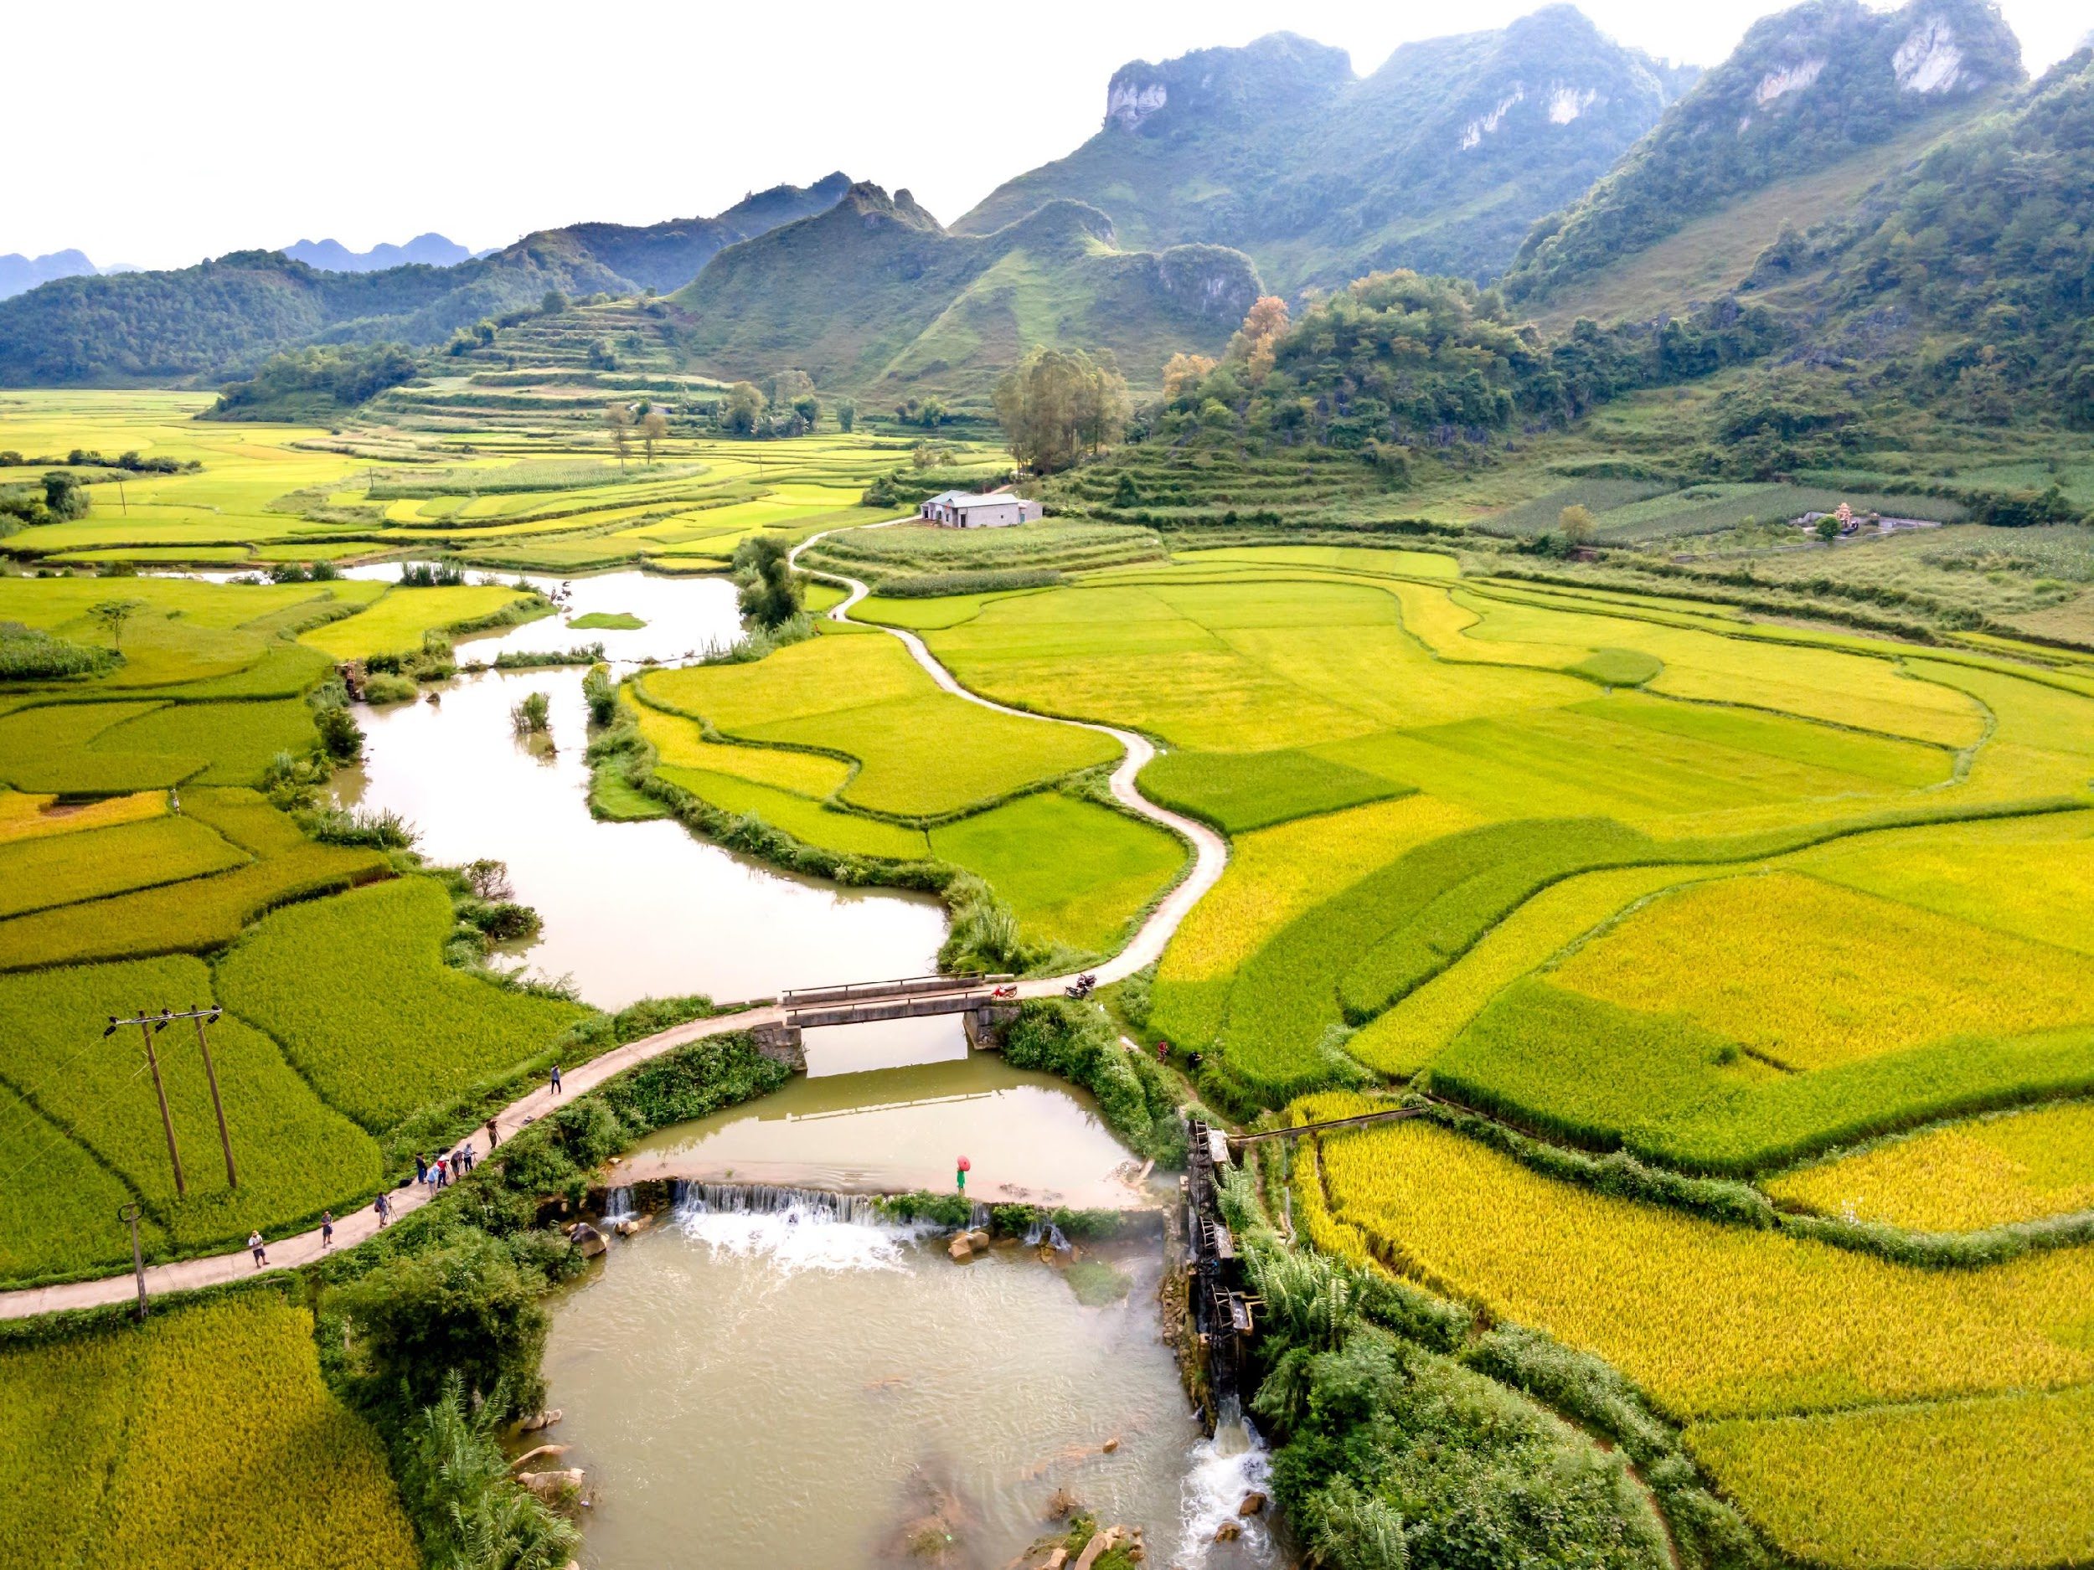
01.
Predictive Model
Develop a model to predict expected farmer yield and identify the most significant predictors

Slide 6
The Problem with Predicting Yield the Simple Way
A standard regression model would fail, not because the model is poorly calibrated
but because it is solving the wrong problem
Ask a regressor to predict yield for a non-seller and it would return something
like 80 kg — a small positive number
5254 Non-selling farmers didn't have a small harvest. They had no harvest.
(Note: 2024-25 was a post-drought recovery season. Some non-sellers carry debt rolled over from the 2023-24 drought, making the non-seller problem especially acute this season.)

Slide 7
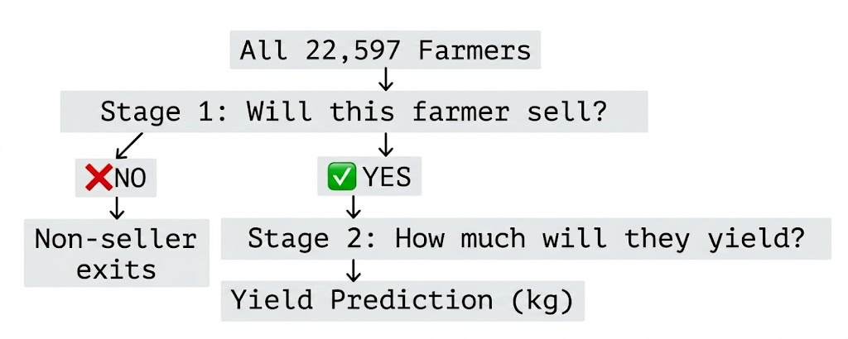
The Solution : Two Stage Hurdle Model
Stage 1 : Classifier– Segregates farmer by seller vs. non seller
Stage 2 : Regressor – If they sold, how much did they sell?
The farmer must clear the first hurdle (the likelihood of selling) before the second stage
makes any prediction about quantity

Slide 8
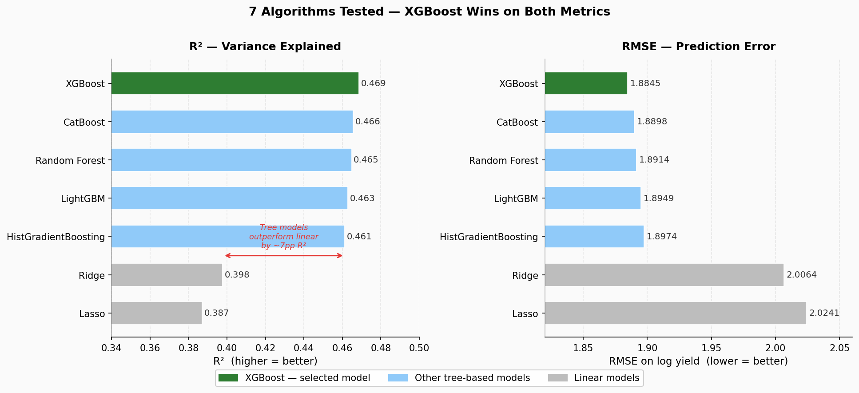
Picking the right model : XGBoost
7 Algorithms tested on identical data and identical cross validation
XGBoost won on every metric
1.8845
RMSE
0.469
R²

Slide 9
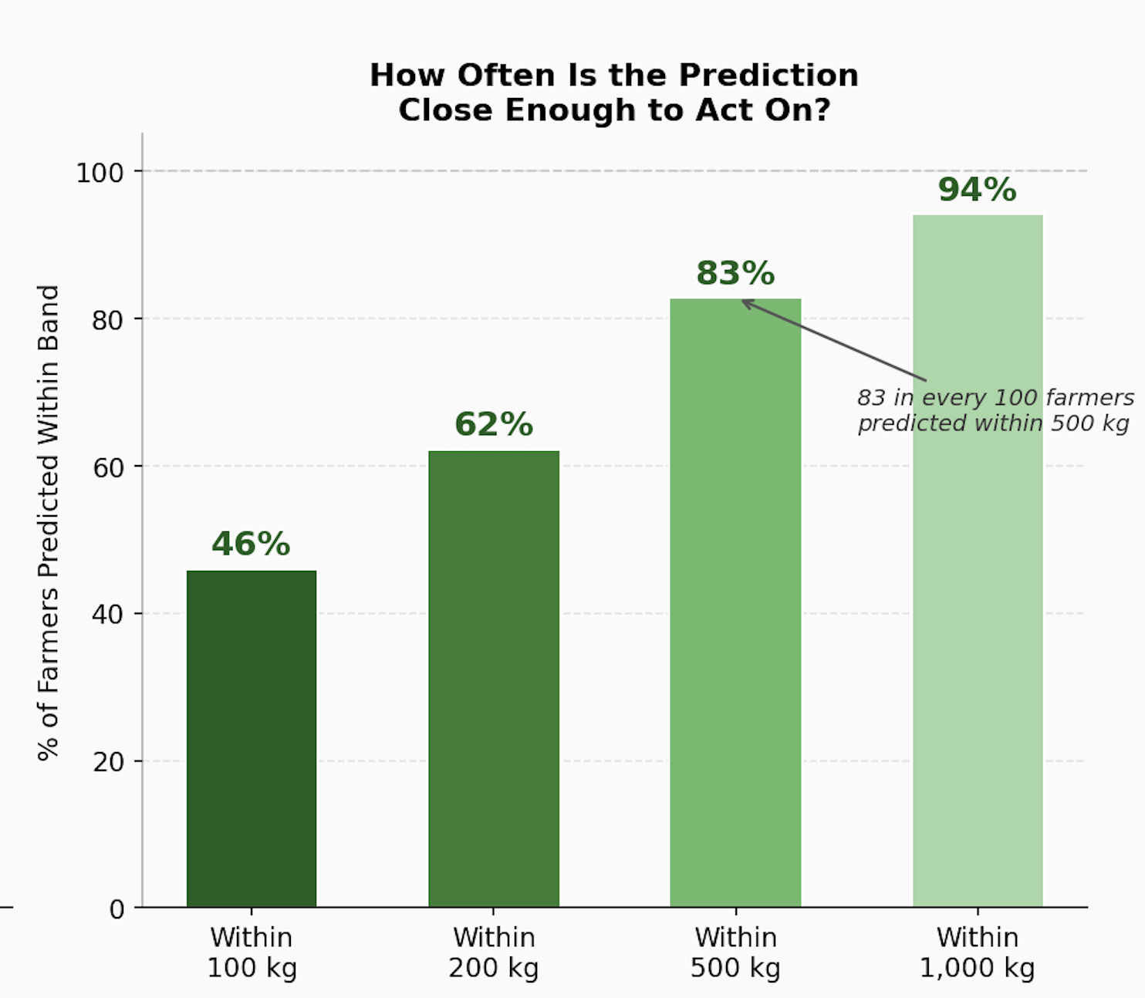
XGBoost Accuracy
After selecting XGBoost, Bayesian hyperparameter tuning improved R² from 0.469 to 0.475
The remaining variation is possibly due to weather shocks (including drought recovery in 2023-24),
soil micro-conditions, and unobserved farmer decisions — factors no model can see

Slide 10
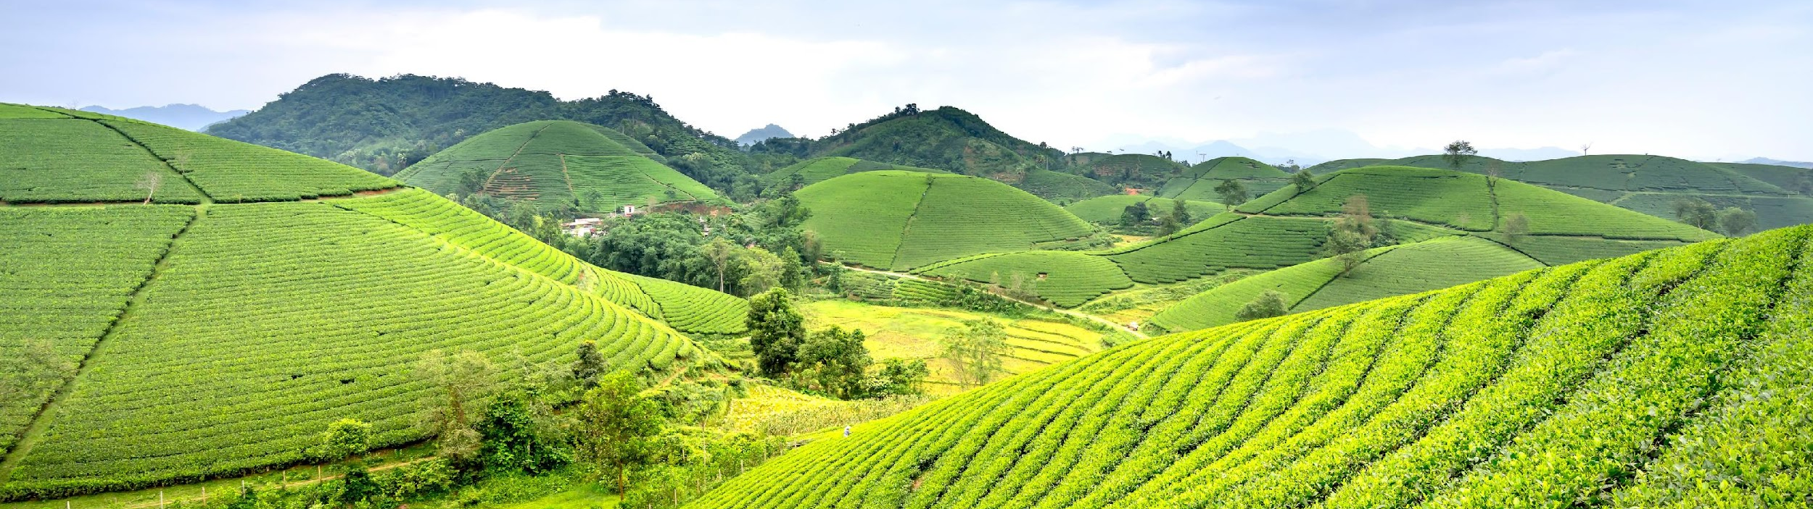
SHapley Additive exPlanations gives us not just a prediction as to what this farmer will yield, it tells us:
"Why does the model predict it and which specific factors are driving it?”
Understanding
SHAP

Slide 11
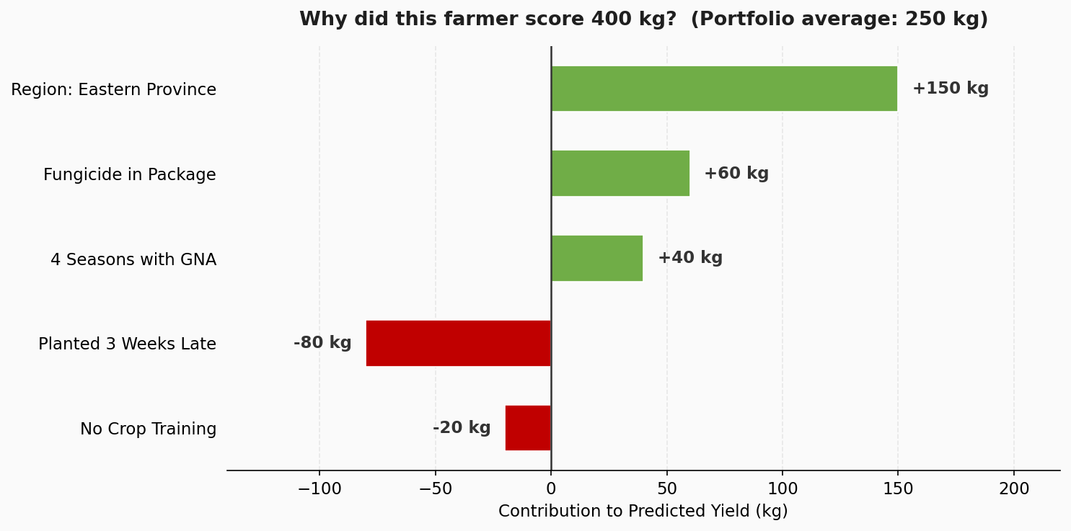
An Example of how SHAP works
If our model says “a farmer will yield 400 kg”. Good Nature Agro needs more than a number — they need to know which factors drove it and which inputs genuinely caused better outcomes!
Every Factor Gets a Score and is Ranked. Positive = Pushed Yield Up. Negative = Pulled Yield Down.

Slide 12
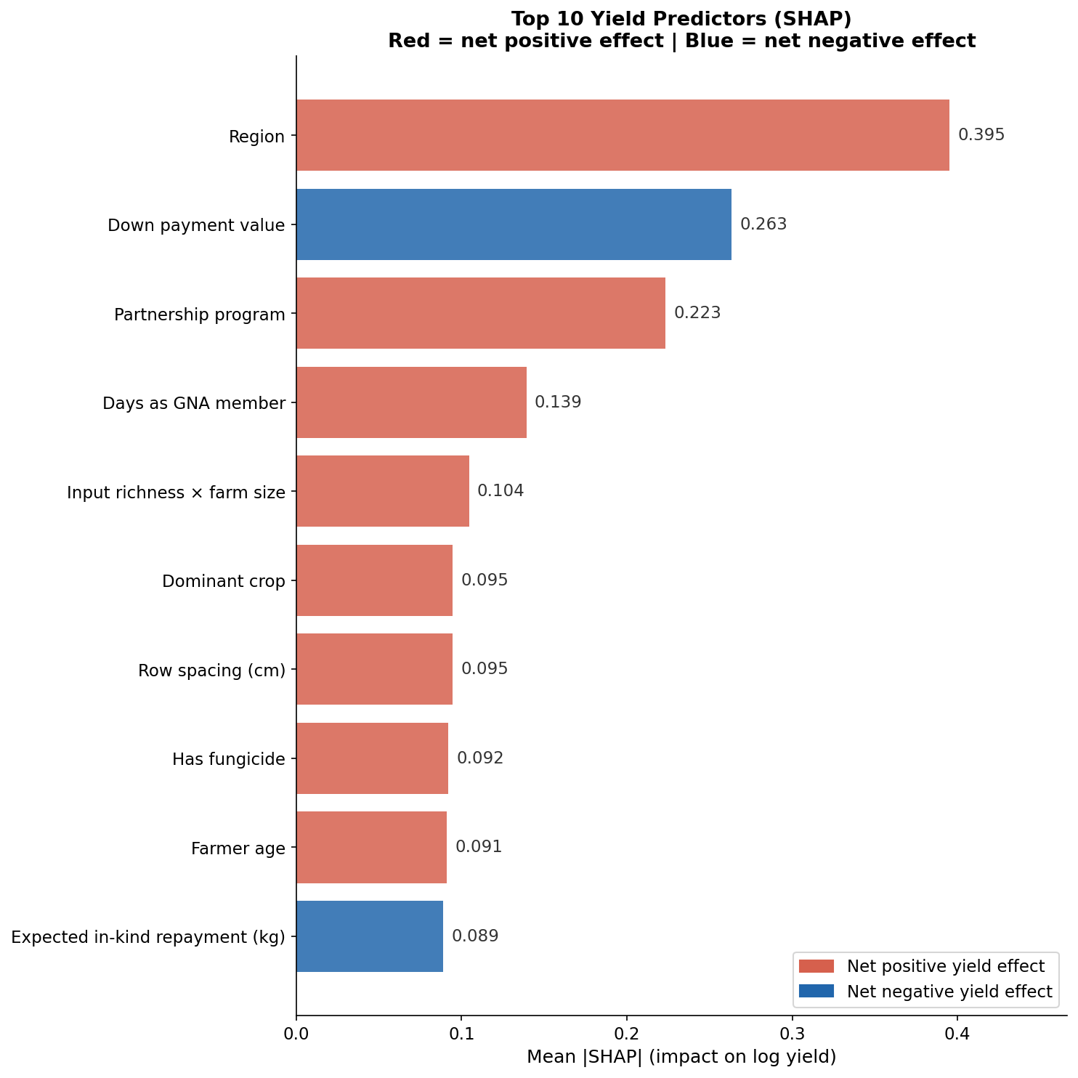
True Drivers of Yield
Applying SHAP for our 22,597 Farmers
A Clear Picture Emerges.

Slide 13
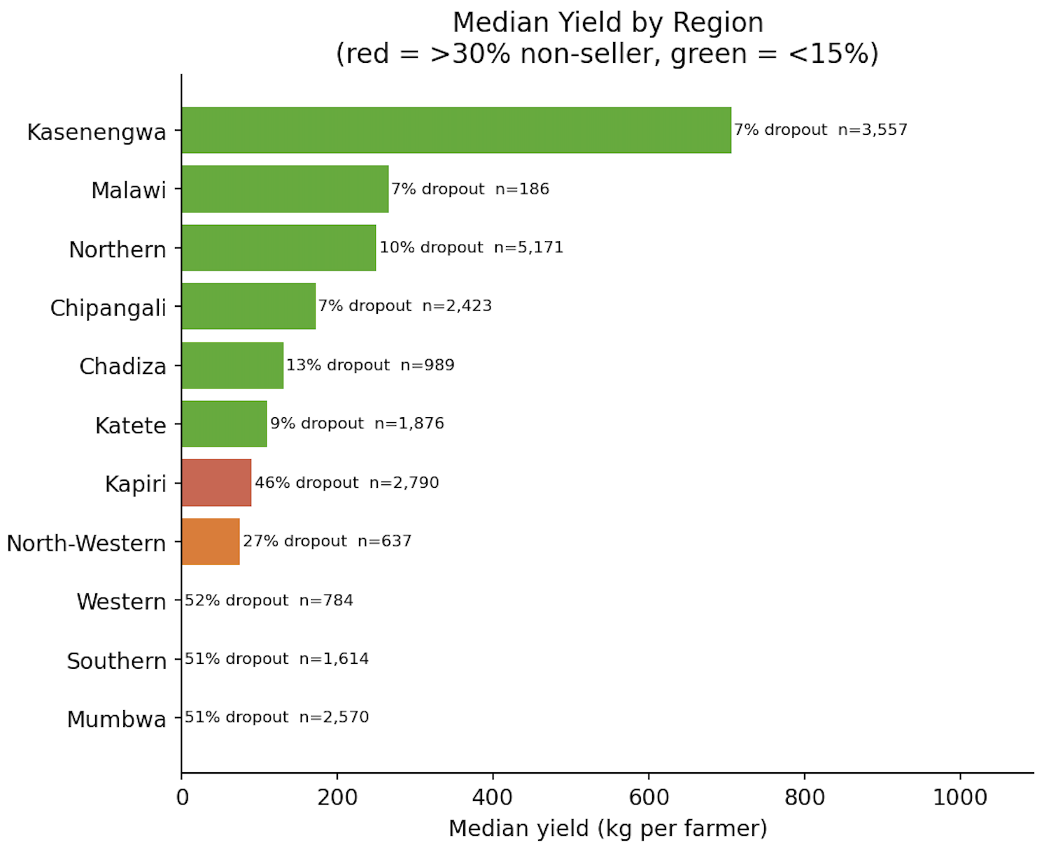
Insight 1 : Geography is Destiny
Kasenengwa leads the portfolio — 706 kg median yield, only 7% dropout across 3,557 farmers
Three regions have collapsed — Western, Southern and Mumbwa each sit above 50% dropout with near-zero median yield. Combined, that is over 4,900 farmers delivering almost nothing
Kapiri is the warning sign — 2,790 farmers, 46% dropout, still showing some yield. This is a region mid-collapse, not yet at zero but heading there
Low dropout and high yield move together – every green region has both. Every red region has neither. Geography determines both outcomes simultaneously

Slide 14
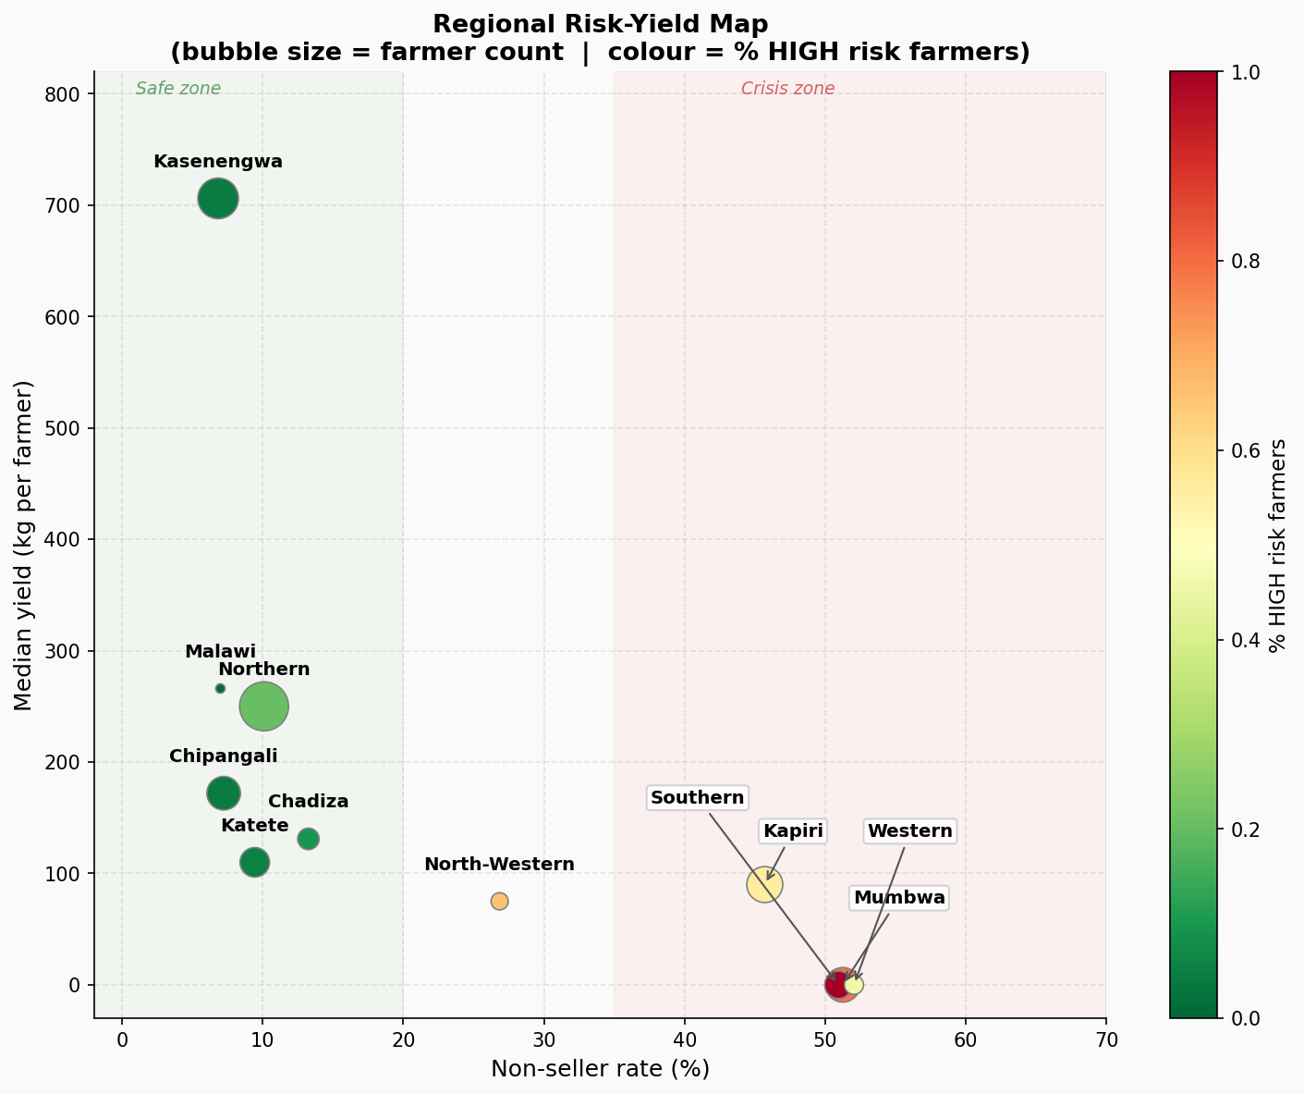
Insight 1 : Geography is Destiny
Safe Zone — Kasenengwa, Northern, Chipangali, Katete, Chadiza and Malawi : low non-seller rates, meaningful yield, deep green. These regions are working
Crisis Zone — Western, Southern and Mumbwa (regions likely disproportionately affected by the 2023-24 drought) : 50%+ non-seller rates, near-zero yield, deep red. These are highly underperforming zones
Northern is the most important region to protect — largest bubble in the safe zone, 5,171 farmers, 10% dropout. Any deterioration here has the largest impact

Slide 15
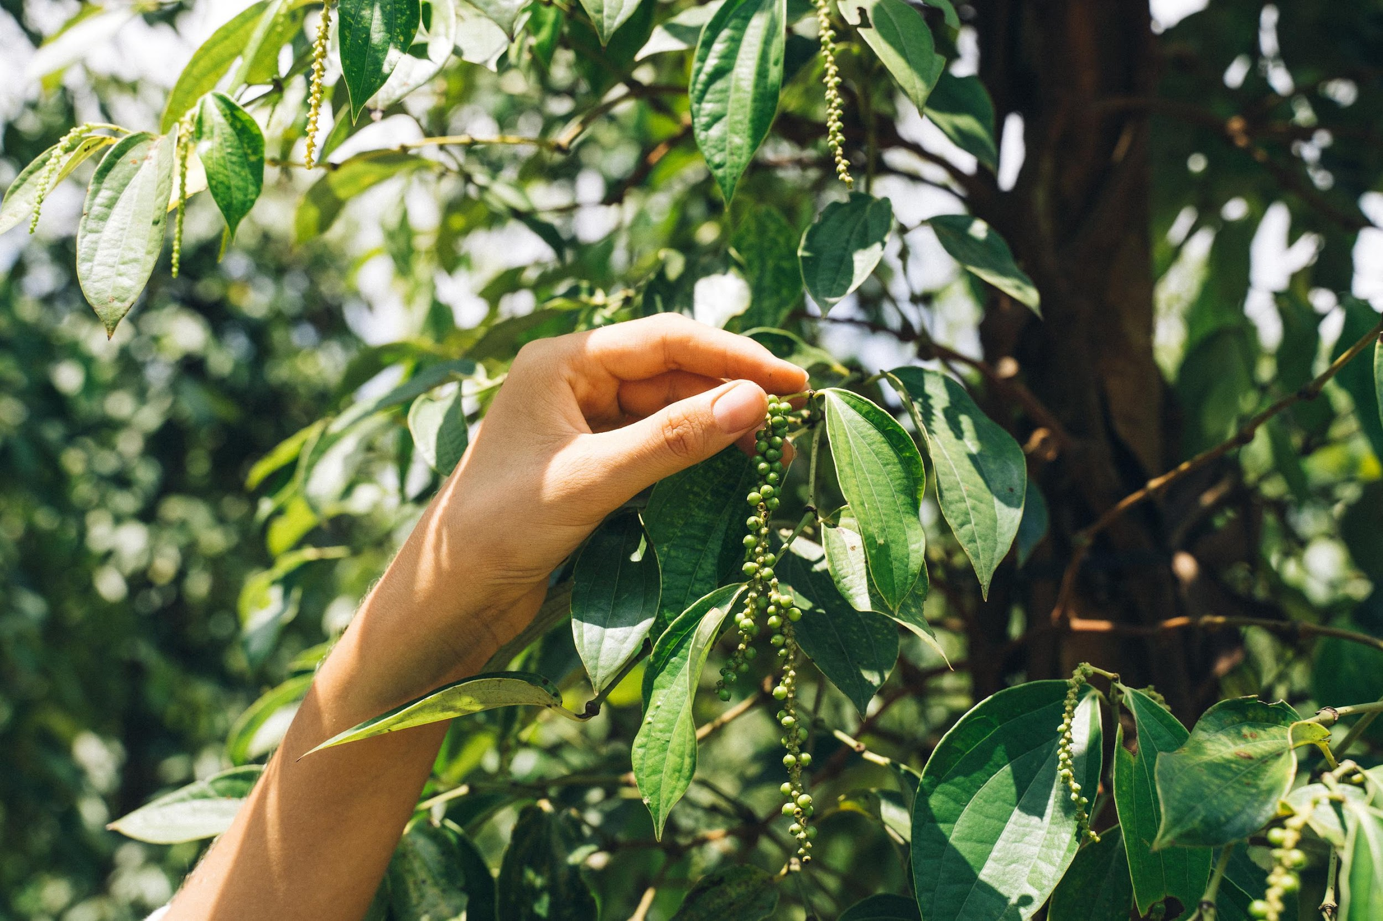
Business Insight
Non-seller rates are geographically structured — not random. This means interventions can be geographically targeted. Not every region needs the same response.

Slide 16
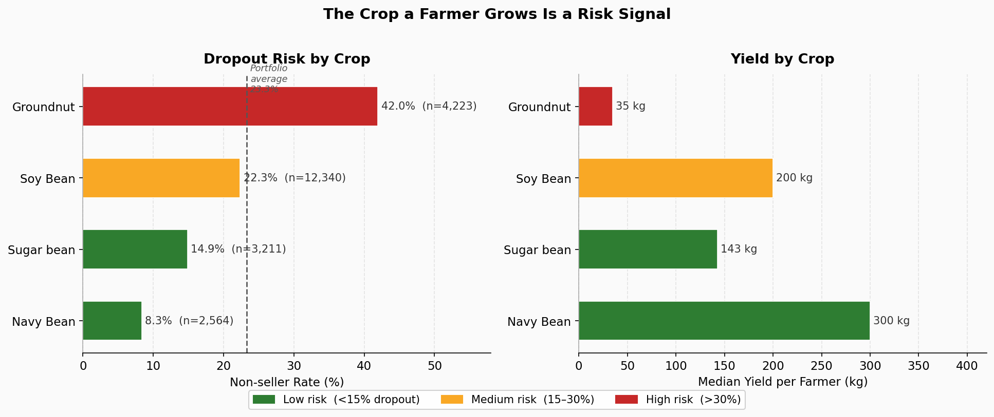
Insight 2 : The Crop a Farmer Grows is a Risk Signal
Groundnut: 42% non-seller rate | Median yield 35 kg
Soy Bean: 22% non-seller rate | Median yield 200 kg
Navy Bean: 8.3% non-seller rate | Median yield 300 kg

Slide 17
Business Insight
Crop selection at loan registration is
not just an agronomic decision, it is a risk decision. Certain crop-zone combinations carry structurally higher dropout risk and should be priced accordingly.

Slide 18
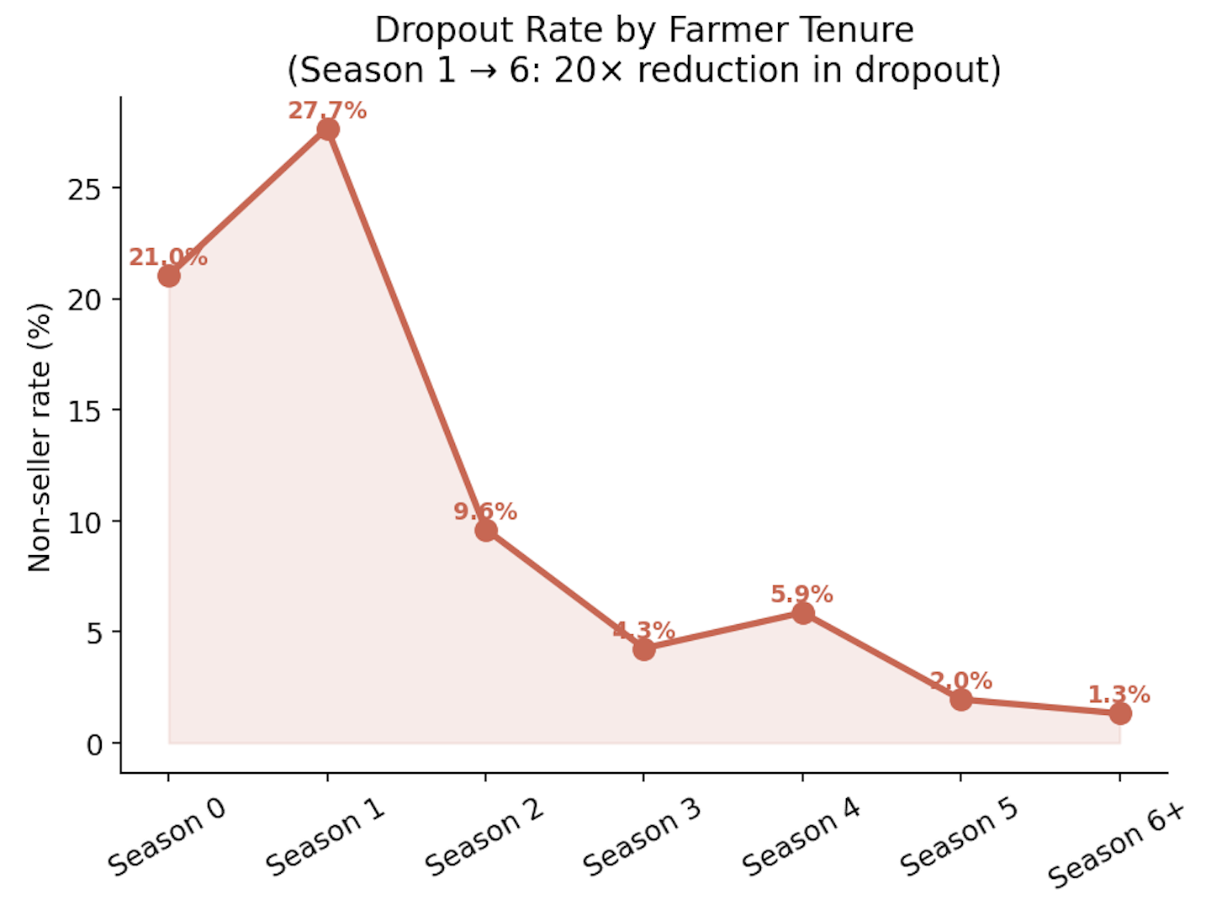
Insight 3 : Loyalty is Key
Season 1 is the danger point — dropout peaks at 27.7%, the highest of any season. This is where Good Nature Agro loses the most farmers
Survive Season 1 and the dropout falls from 27.7% to 9.6% by Season 2, then to 4.3% by Season 3

Slide 19
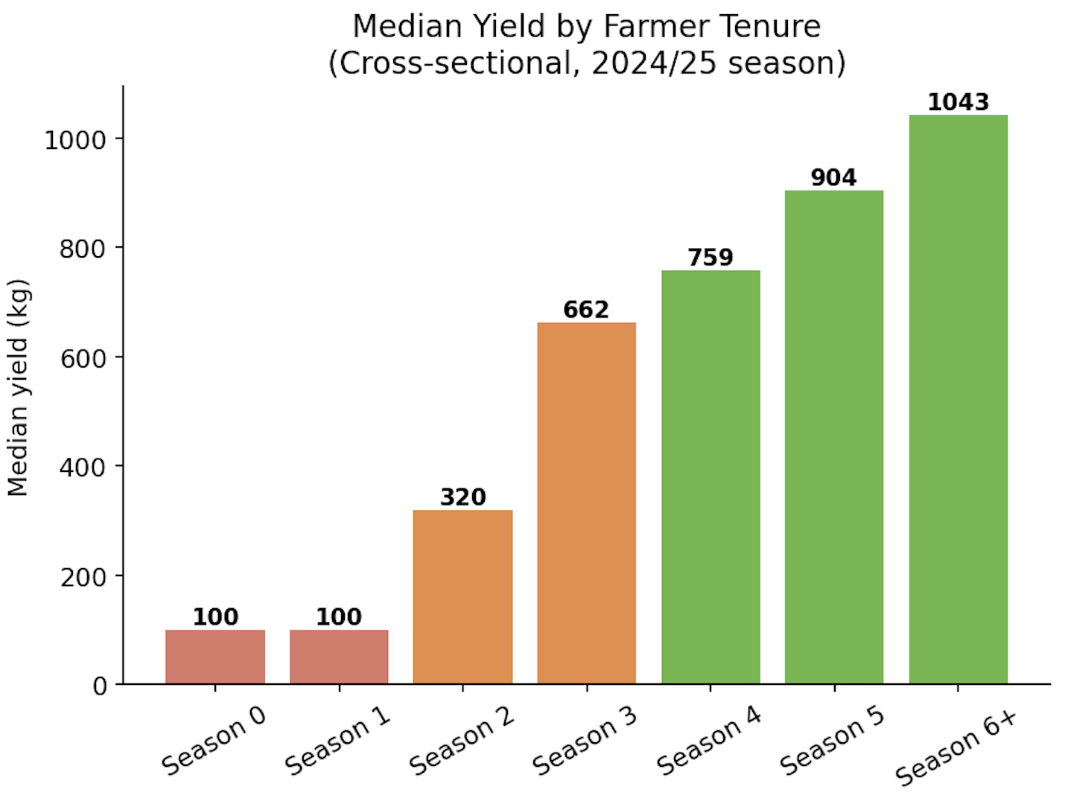
Insight 3 : Loyalty is Key
Yield follows the same curve — 100 kg at Season 1, 320 kg by Season 2, 1,043 kg by Season 6+. A 10x increase over the farmer's lifetime with Good Nature Agro
Season 6+ farmers are Good Nature Agro's most reliable asset with 1.3% dropout rate, 1,000+ kg median yield. These farmers have minimal churn risk
The first two seasons are make or break — every farmer who survives Season 1 and 2 is on a trajectory toward long-term productivity and loyalty

Slide 20
Business Insight
Invest disproportionately in Season 1 farmer support. It is the single intervention with the highest long-term return in Good Nature Agro's entire portfolio.

Slide 21
02.
Input Effectiveness
Identify the components of the loan package that are most strongly associated with improved yield

Slide 22

Which Inputs Genuinely Drive Yield?
Good Nature Agro provides fertilizer, fungicide, gypsum, lime, inoculant, insecticide and seed guard
The problem: Farmers who use more inputs may also tend to be more experienced, in better zones, or on larger farms
If we just compare "used input" vs "didn't use input" — we are comparing different types of farmers, not the input itself
SHAP controls for all of this. What remains is the genuine effect of the input alone.

Slide 23
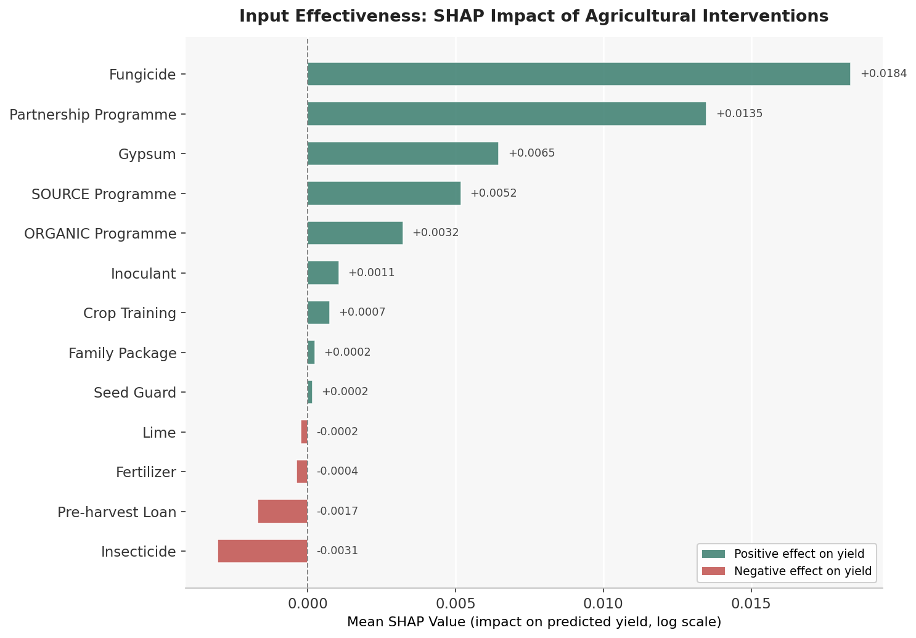
Impact of Inputs (Interventions)
Applying SHAP for our 22,597 Farmers
A Clear Picture Emerges.

Slide 24
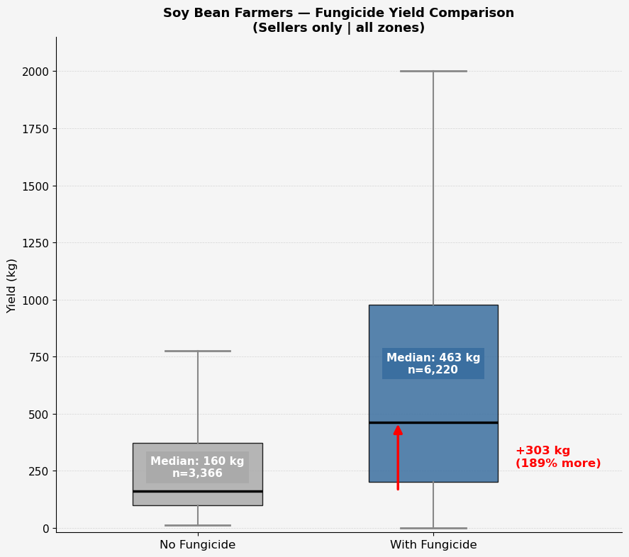
Insight 4 : The Highest-Impact Input that
most Soy Bean Farmers Don't Have
Fungicide ranks as the #1 controllable input in the entire model with a consistent positive effect across crop types
Soy Bean is the largest crop type at 55% of the portfolio
Among Soy Bean farmers across all zones — those with fungicide yield a median of 463 kg
Those without fungicide yield a median of 160 kg — the same crop, the same zones, a 189% difference
Yet, 45% of Soy Bean farmers currently have no fungicide in their loan package

Slide 25
Business Insight
Making fungicide the default in every Soy Bean package is the highest-return input decision Good Nature Agro can make.

Slide 26
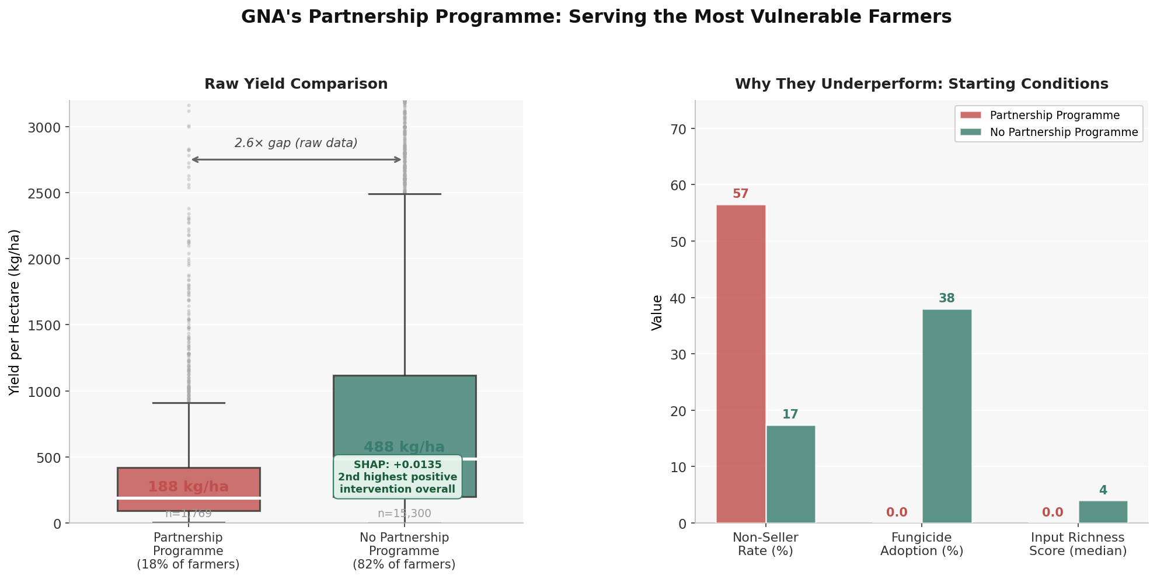
Insight 5 : The Partnership Programme Is Working — Just Not Where You'd Expect
18% of farmers are enrolled in the Partnership Programme — concentrated in Mumbwa, Kapiri, and North-Western
On the surface: programme farmers yield 188 kg/ha vs 488 kg/ha for others, a 2.6 times gap
But this is misleading: programme farmers have 0% fungicide adoption, input richness score of 0, and a 57% non-seller rate and they belong to Good Nature Agro's most disadvantaged cohort
After controlling for all these disadvantages, the model assigns the programme a SHAP of +0.0135 — the 2nd highest positive intervention in the entire dataset
Hence, the programme isn't failing, it's serving the hardest cases and still adding measurable value

Slide 27
Business Insight
The Partnership Programme is Good Nature Agro's most important safety net — pairing it with even one additional input (fungicide or inoculant) for enrolled farmers is the highest-leverage investment to make.

Slide 28
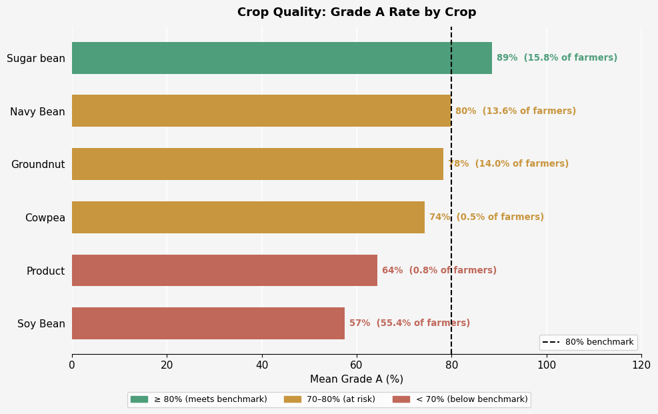
Insight 6 : The Poor Quality of Soy Bean
Soy Bean accounts for 55.4% of all farmers — yet has the lowest Grade A rate of any major crop at 57%, well below the 80% benchmark
Sugar Bean is the only crop comfortably above benchmark at 89%
Navy Bean sits exactly at the 80% benchmark and might be at risk of falling below the benchmark

Slide 29
Business Insight
Over half of Good Nature Agro's farmer base is producing below-benchmark quality. Soy Bean is the largest part of the portfolio, yet suffers from the poorest quality. Targeted agronomic support for Soy Bean farmers is the highest-impact quality intervention available.

Slide 30
03.
Risk Identification
Can high risk farmers be segmented and flagged early in the season

Slide 31
How Risk Tiers are assigned
Each farmer gets a single score (Expected Yield) —
that combines both the chance they sell back
AND how much they'll produce if they sell back
The Formula :
Expected Yield = P (sells back) × E [yield | sells back]
Stage 1 Stage 2
(classifier) (regressor)
We segment farmers into equal thirds by expected yield — the bottom third flagged HIGH, middle third MEDIUM, top third LOW.

Slide 32
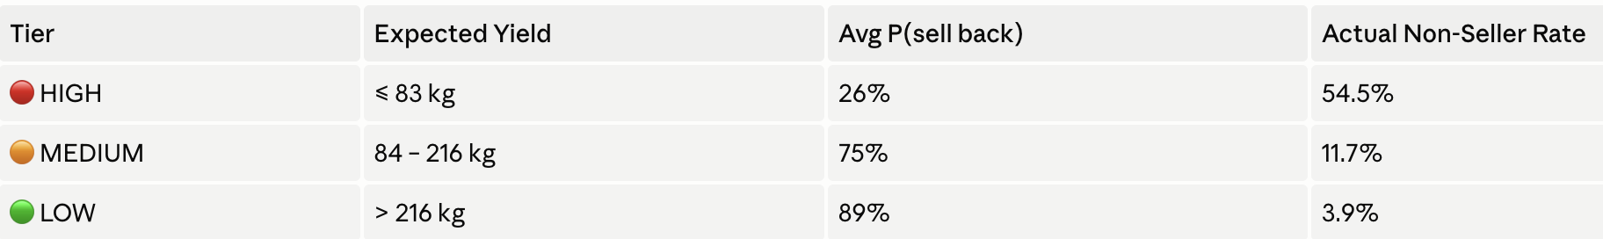
Risk Tier Thresholds
*(The 83 kg and 216 kg cutoffs emerge directly from the dataset.
Thresholds are set at the 33rd and 67th percentiles — equal thirds of the farmer population
A farmer in HIGH tier has only a 26% chance of selling back & their expected contribution is nearly zero
This single score collapses two separate model outputs into one actionable, field-ready label

Slide 33
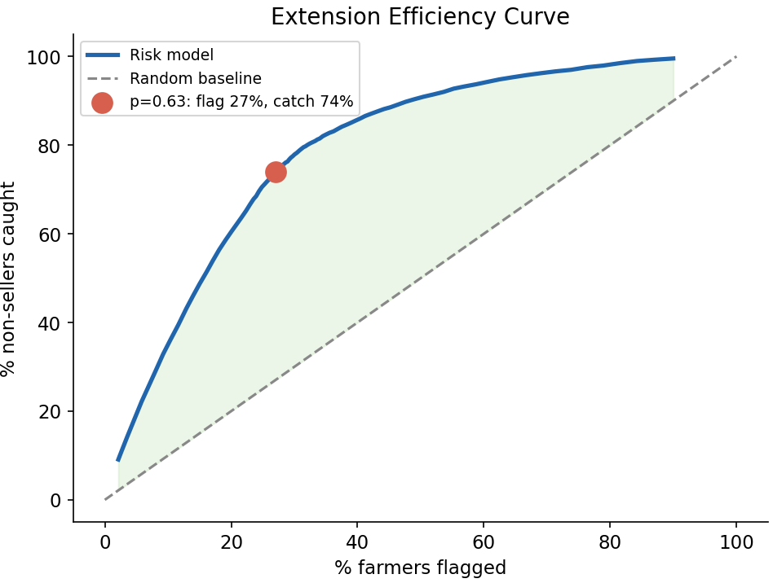
Tier Model Accuracy : The Model catches 3 in 4 non-sellers!
By flagging only 27% of the farmers, the model catches 74% of non-sellers
A random approach would require flagging 74% of farmers to achieve the same catch rate — 2.7× less efficient
We can reach 3 out of 4 non-sellers while spending roughly a quarter of the extension costs.

Slide 34
Business Insight
By leveraging this risk tier model, Good Nature Agro can implement targeted field visits, control loan exposure, and execute early interventions for HIGH risk farmers

Slide 35
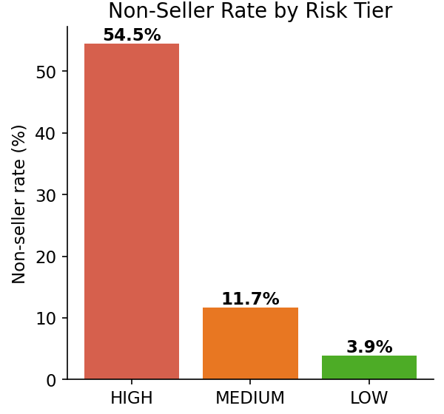
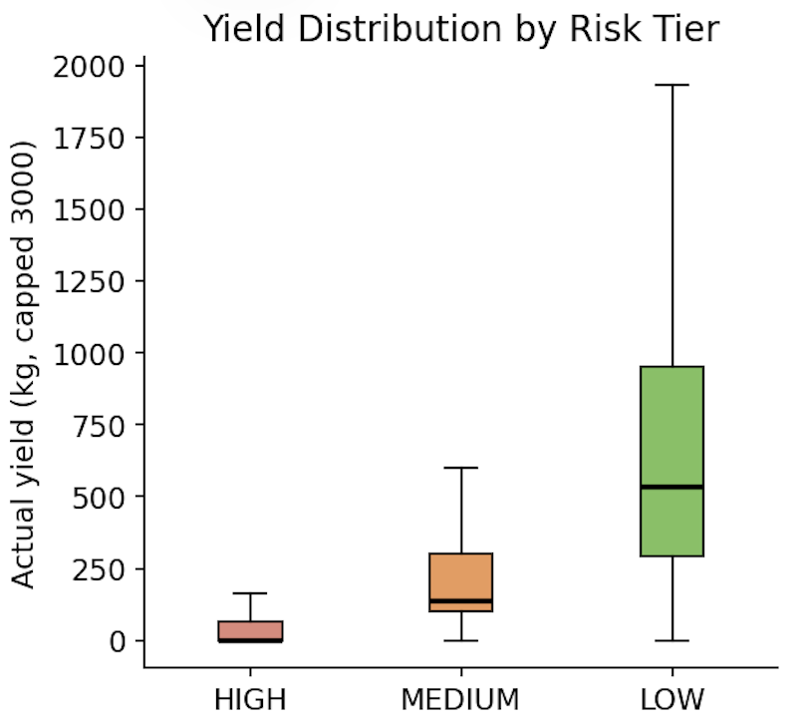
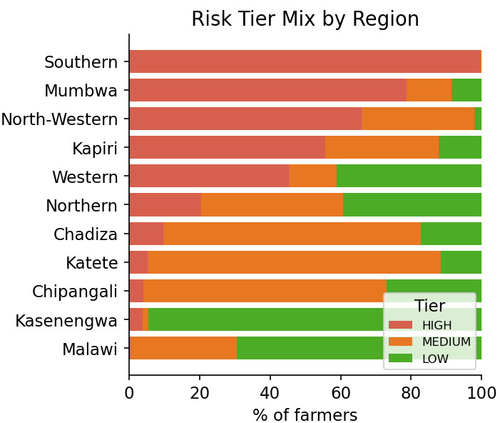
Insight 7 : 54% of HIGH-Risk Farmers Never Sell Back!
Non-seller rate: HIGH = 54.5% | MEDIUM = 11.7% | LOW = 3.9% — the model cleanly separates farmers who will and won't sell back
Yield follows the same pattern: HIGH-tier median yield is near zero; LOW-tier median is ~550 kg
Risk is regionally related: Southern and Mumbwa are almost entirely HIGH risk; Kasenengwa is predominantly LOW risk

Slide 36
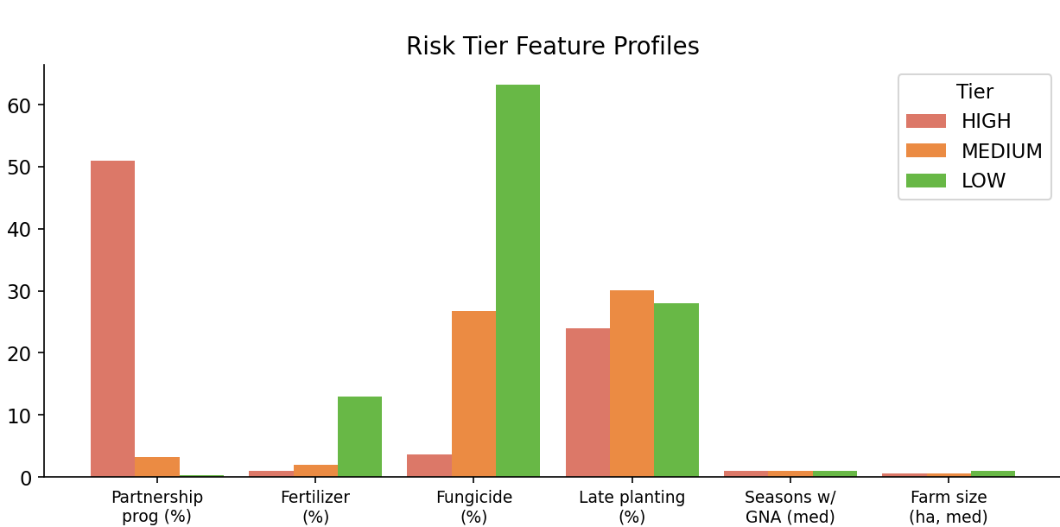
Insight 8 : The Profile of a High-Risk Farmer
Partnership Programme farmers make up 51% of HIGH Tier vs just 2% of LOW Tier
Fungicide adoption is 4% in HIGH Tier vs 63% in LOW Tier, suggesting fungicide drives low risk

Slide 37
Business Insight
Fungicide must be made the priority intervention for HIGH-risk farmers and, the support for Partnership Programme farmers needs to be redesigned

Slide 38
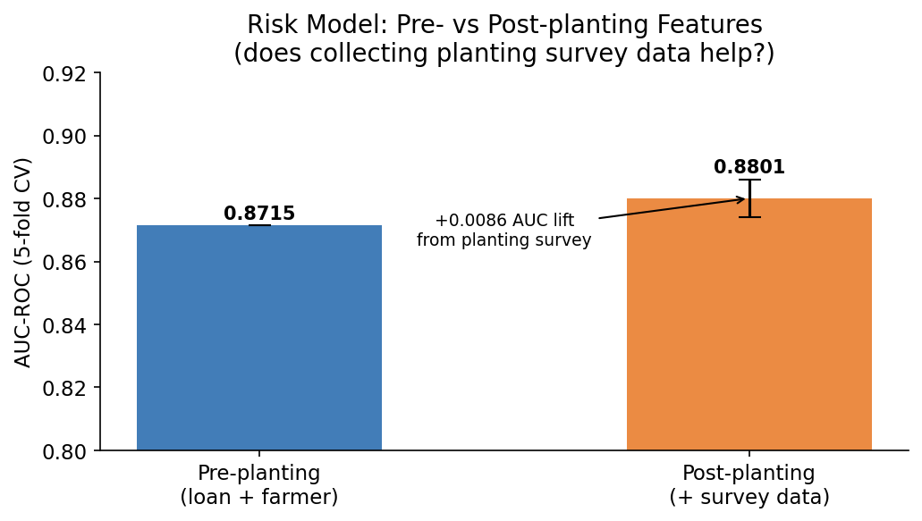
Insight 9 : Risks must be flagged before the season starts
AUC 0.871 using only loan registration data — before a seed is planted
Full model (+ planting survey) reaches AUC 0.880 (+0.009 lift)
Risk can be flagged at the moment of loan approval, months before season begins
Enables proactive support, not reactive damage control

Slide 39
5254
FARMERS CAN BE RECOVERED!

Slide 40
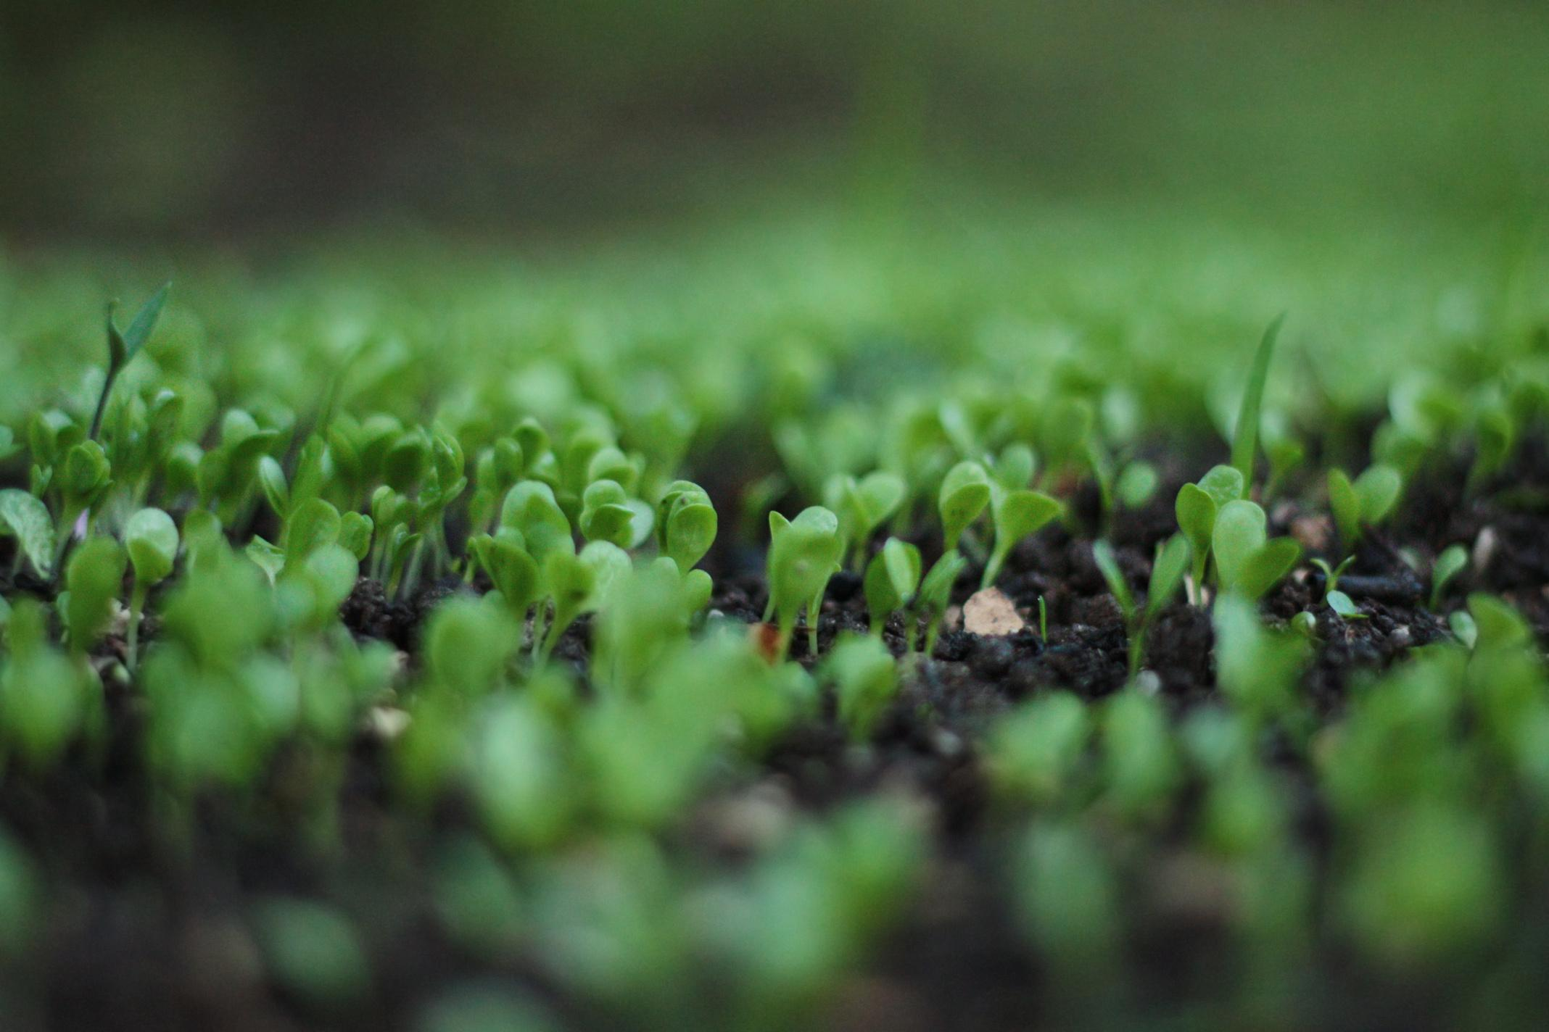
Actionable Recommendations
Make fungicide the default in every Soy Bean package 45% of Soy Bean farmers — Good Nature Agro's largest crop have no fungicide. Those with fungicide yield 464 kg vs 160 kg without, a 189% difference. This is the single highest-return input decision available.
Deploy the risk model at loan registration The model flags 27% of farmers and catches 74% of non-sellers using only data that exists before a seed is planted. Apply HIGH-risk flags to trigger field visits, reduced loan exposure, and targeted early support.
Invest disproportionately in Season 1 farmer retention Season 1 is where Good Nature Agro loses the most farmers (27.7% dropout). Farmers who survive it drop to 9.6% by Season 2 and 1.3% by Season 6+. Every Season 1 farmer retained is a long-term asset. This is the intervention with the highest lifetime return.

Slide 41




Conclusion
Our model built entirely from existing data can identify 3 in 4 at-risk farmers before a seed is planted.
The 5 recommendations do not require new data collection, new infrastructure, or new programmes. They require applying our models!

